Slide 1
B.Sc. Part-II
Sem-IV
Paper : Wave, Acoustics & Laser
Ultrasonics
Dr. Pramod Kumar Singh
Assistant Professor & Head
Department of Physics
Shri Sadguru Saibaba Science & Commerce College, Ashti

Slide 2
Sound
Sound is a form of energy.
It is a vibration that propagates in the form of an acoustic wave.
Sound waves are longitudinal waves and hence it requires a medium for propagation such as solid, liquid or gas.
Sound waves are produced as a result of vibrations.
When any object moves back and forth rapidly in a certain medium, it causes movement in the particles of that medium, resulting in sound wave.
Example- when a school bell rings, parts of the bell vibrates and we could able to hear the sound.

Slide 3
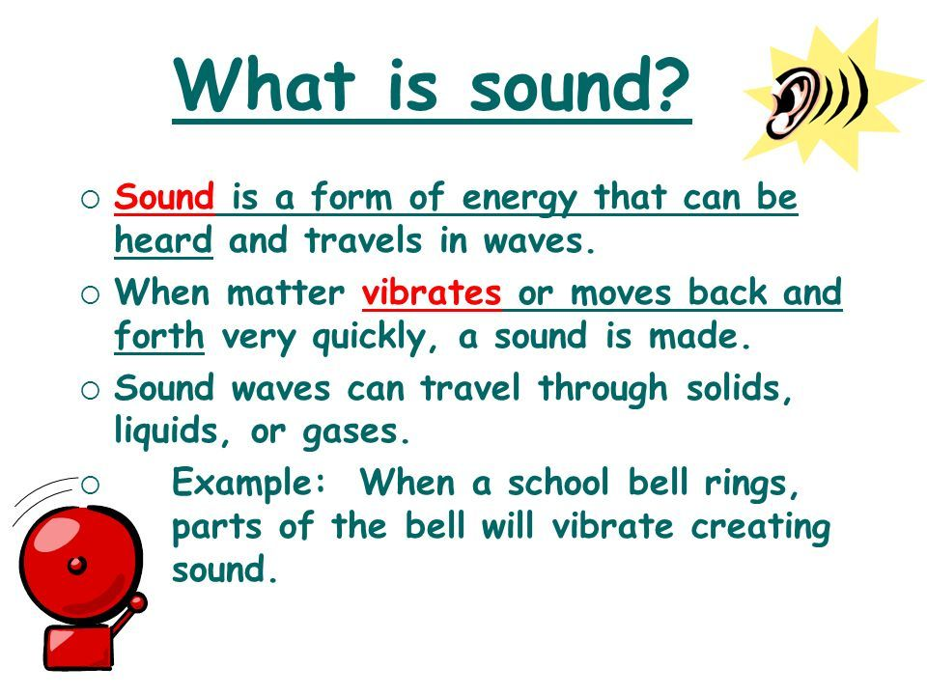
Sound

Slide 4
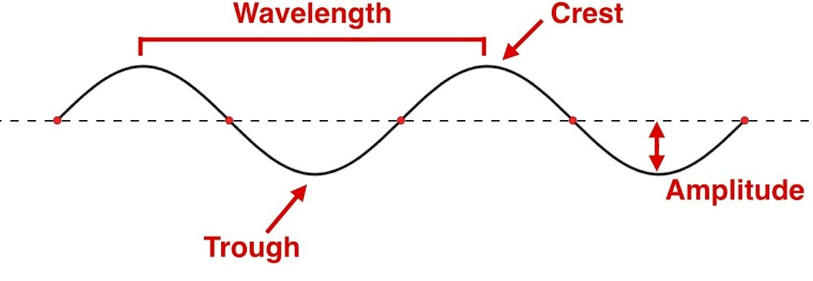
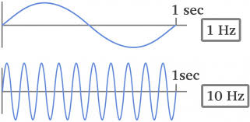
Sound: Wavelength, Amplitude & Frequency

Slide 5
Spectrum of Sound
Spectrum of Sound
Infrasonic (Frequency < 20 Hz)
Audible (20 Hz - 20 KHz)
Ultrasonic (Frequency > 20 KHz)
20 Hz
20 KHz
200 MHz
Infrasound
Audible sound
Ultrasound

Slide 6
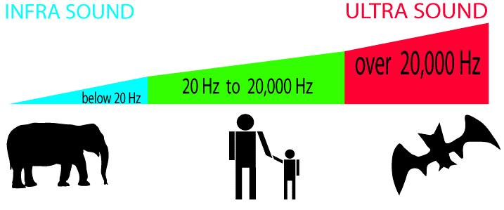
Spectrum of Sound
Human ear is sensitive to sound of frequency 20 Hz to 20 KHz. This range is known as audible range for humans.
Sound waves of frequency less than 20 Hz are called Infrasonic waves. It is not audible to human, however, animals like whales, elephants, rhinos, giraffes are sensitive to infrasound.

Slide 7
Spectrum of Sound
The sound waves of frequency greater than 20 KHz are celled ultrasonic waves. The frequency is beyond the highest audible frequency.
The animals like dog, bat and dolphins are sensitive to ultrasound.

Slide 8
Ultrasonic waves
Properties
Frequency greater than 20 KHz.
Due to higher frequency , wavelength is low (1.6 cm).
Speed of ultrasound does not depend upon its frequency.
Speed is dependent of the material/medium through which the waves are travelling.
Ultrasonic waves shows negligible diffraction due to shorter wavelength.
Ultrasonic waves are directional, it can be transmitted over a large distance.
Ultrasonic waves reflects partially when it travels from one medium to another.

Slide 9

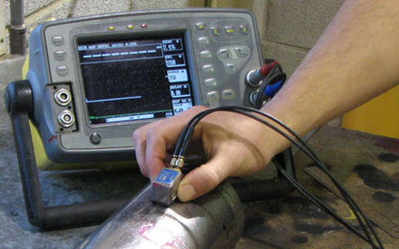
Ultrasonic waves
Uses
Ultrasonic cleaning
Flaw detection

Slide 10
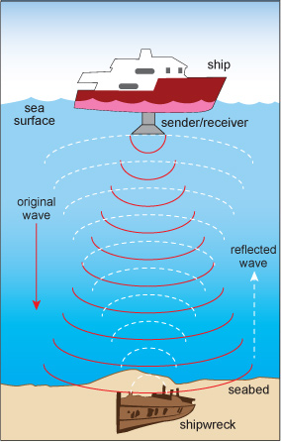

Ultrasonic waves
Uses
Ultrasound (sonography)
SONAR

Slide 11
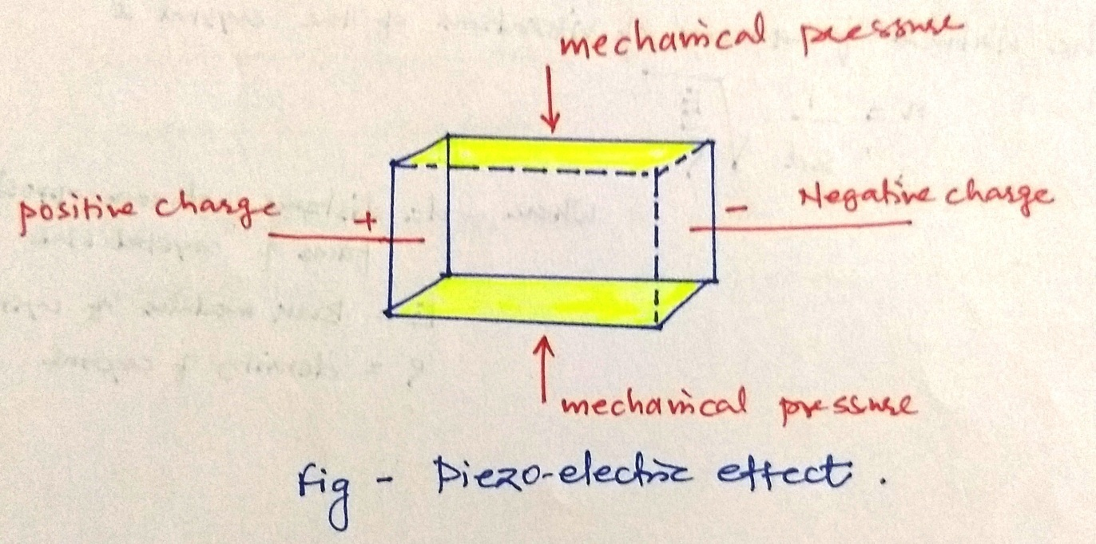
Piezoelectric Effect
When a mechanical pressure is applied across the two opposite faces of quartz crystal, it develops a potential difference across other two faces of the crystal. This phenomenon is known as Piezoelectric Effect.
The quantity of charge produced is proportional to the pressure applied across the crystal.

Slide 12
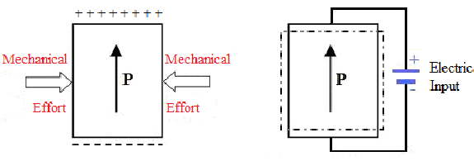
Inverse Piezoelectric Effect
Piezoelectric Effect
Inverse Piezoelectric Effect

Slide 13
Production of Ultrasonic Waves
Inverse Piezoelectric Effect
Ultrasonic waves are produced using Inverse Piezoelectric Effect.
According to inverse piezoelectric effect, when an electric potential is applied across the faces of the piezoelectric crystal, the crystal undergoes a strain.
If the direction of applied potential is reversed, it results in reversal of strain. Hence, if a high frequency AC voltage is applied, it results in forced vibration in the crystal. This phenomenon is known as inverse piezoelectric effect.
When the frequency of vibration becomes equal to the natural frequency of the crystal, resonance takes place, resulting in sufficiently large vibration.
These high frequency vibrations causes the formation of ultrasonic waves.

Slide 14
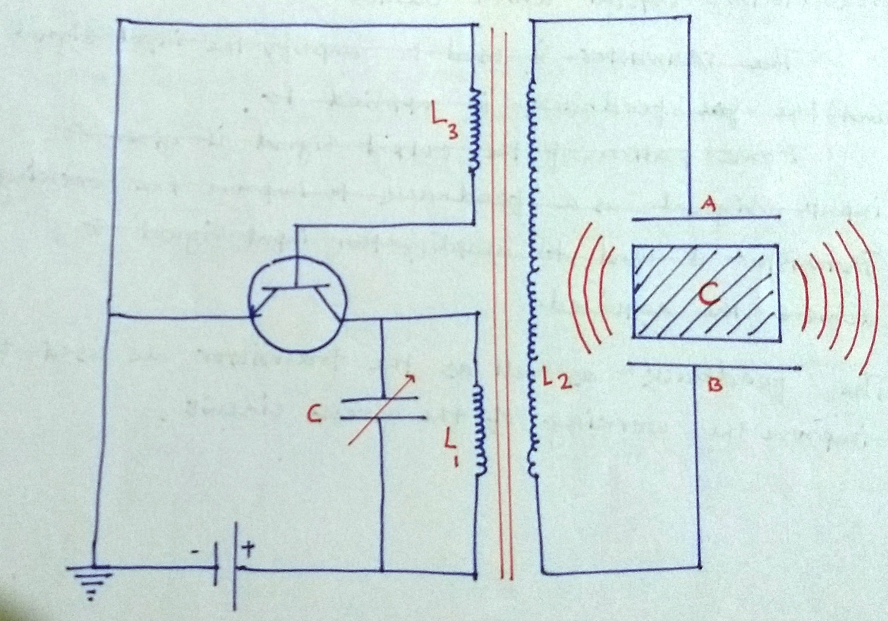
Production of Ultrasonic Waves
Ultrasonic waves are produced using Inverse Piezoelectric Effect.

Slide 15
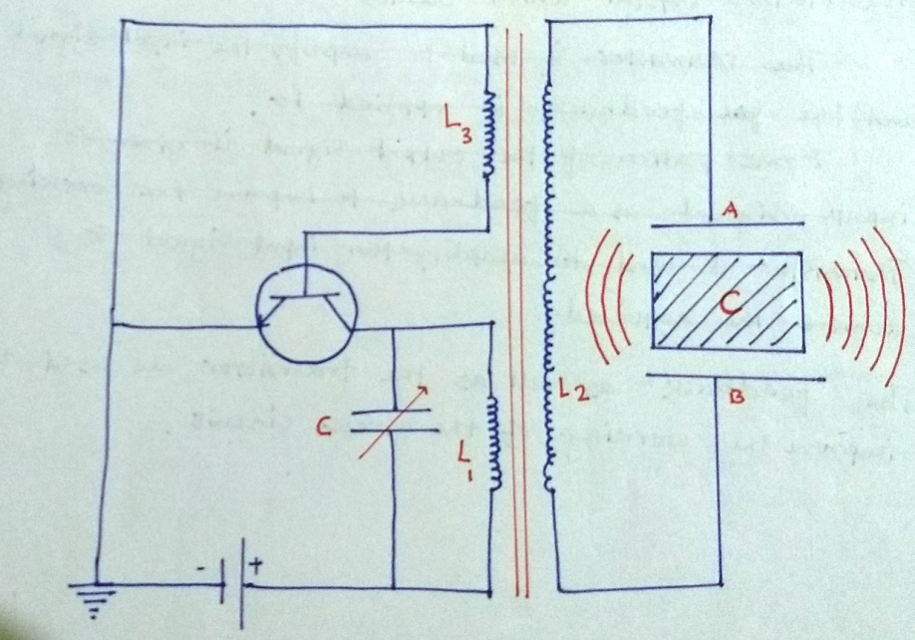
Production of Ultrasonic Waves
Ultrasonic waves are produced using Inverse Piezoelectric Effect.
when the high frequency AC voltage is applied to plates A and B, inverse piezoelectric effect takes place.
The crystal begins to contract and expand periodically which causes compressions and rarefaction in the surrounding medium.
When the crystal vibrates with its natural frequency, resonance occurs and amplitude of vibration becomes very large, resulting in production of ultrasonic waves.

Slide 16
Thank You !
www.themegallery.com

